Slide 1



Review 1 VISIONARY CAREER ASSISTANCE: AI-DRIVEN ADAPTIVE LEARNING FOR UNDERPRIVILEGED STUDENTS Project Category: RESEARCH
Guide Name – Dr MOHAMMAD SHAHNAWAZ HUSSAIN
Student Name & Registration Number – Atharv Dobhal (RA2211047010134) , Diyansh Bafila (RA2211047010068)

Slide 2
Abstract
Visionary Career Assistance is an advanced career guidance platform that integrates data analytics and mentorship to help students make informed career decisions. It combines a Data-Driven Analysis Dashboard and a Mentor Connections Platform to analyze role model influences, socioeconomic backgrounds, and behavioral trends. Built using React and TypeScript for the frontend and Flask with Python for the backend, it employs sentiment analysis, machine learning, and data visualization to deliver personalized insights. The platform promotes equity, supports SDG 4,and ensures mobile responsiveness with real-time analytics.

Slide 3
Introduction
Educational and career inequity persists as a critical global issue, with students from disadvantaged backgrounds facing systemic barriers that restrict access to guidance, resources, and informed career pathways. Existing AI-driven educational systems largely focus on academic performance and personalization, yet fail to incorporate the socio-economic, familial, and psychological factors that shape career trajectories. This research introduces Visionary Career Assistance, a reinforcement learning–based framework that integrates multidimensional student profiles—including academic, socio-economic, and home-environment indicators—to deliver adaptive and equitable career interventions. The study proposes a fairness-aware RL model, balanced reward design, and empirical validation in low-resource simulated environments to address career development inequity.

Slide 4
Research Objectives
Epics
Epic A — Survey Ingestion & Validation Reliable, deduplicated, schema-checked data so downstream analytics trust the inputs.
Epic B — Career Confidence Analytics Model behavioural, background, income, and role-model factors to score confidence and pinpoint drivers.
Epic C — Recommendations & Mentor Matching Turn analytics into actionable guidance and mentor matches that adapt with feedback.
Epic D — Dashboards & Reports Communicate insights (student + cohort) via interactive views and exportable reports.
Alignment to the Problem
Clean data (A) → removes noise and bias → better signals for confidence scoring.
Robust analytics (B) → identify which factors most affect student trajectories.
Actionable outputs (C) → close the loop with suggestions and human support.
Clear visibility (D) → keeps admins/mentors informed and able to intervene early.

Slide 5
Project Scope
In Scope
Collect and validate student survey data (background, behavior, academics, income, role models); deduplicate and store in DB.
Run sentiment and statistical analyses, including hierarchical regression for career confidence; log metrics and cache/store outputs.
Generate personalized recommendations and mentor matches using vector similarity and feedback-driven reweighting.
Expose secure APIs for authentication, assessments, analytics, and report retrieval; support CORS and basic real-time updates.
Provide React/TypeScript dashboards for student/cohort insights, charts, and downloadable PDFs/CSVs.
Out of Scope (for now)
Full production-grade multi-tenant scaling (SLA/SLOs, high availability, autoscaling).
Advanced AI/ML beyond current sentiment and regression models (e.g., deep learning/NLP embeddings training).
Complex billing/commercialization, parental consent workflows, or third-party LMS integration.

Slide 6
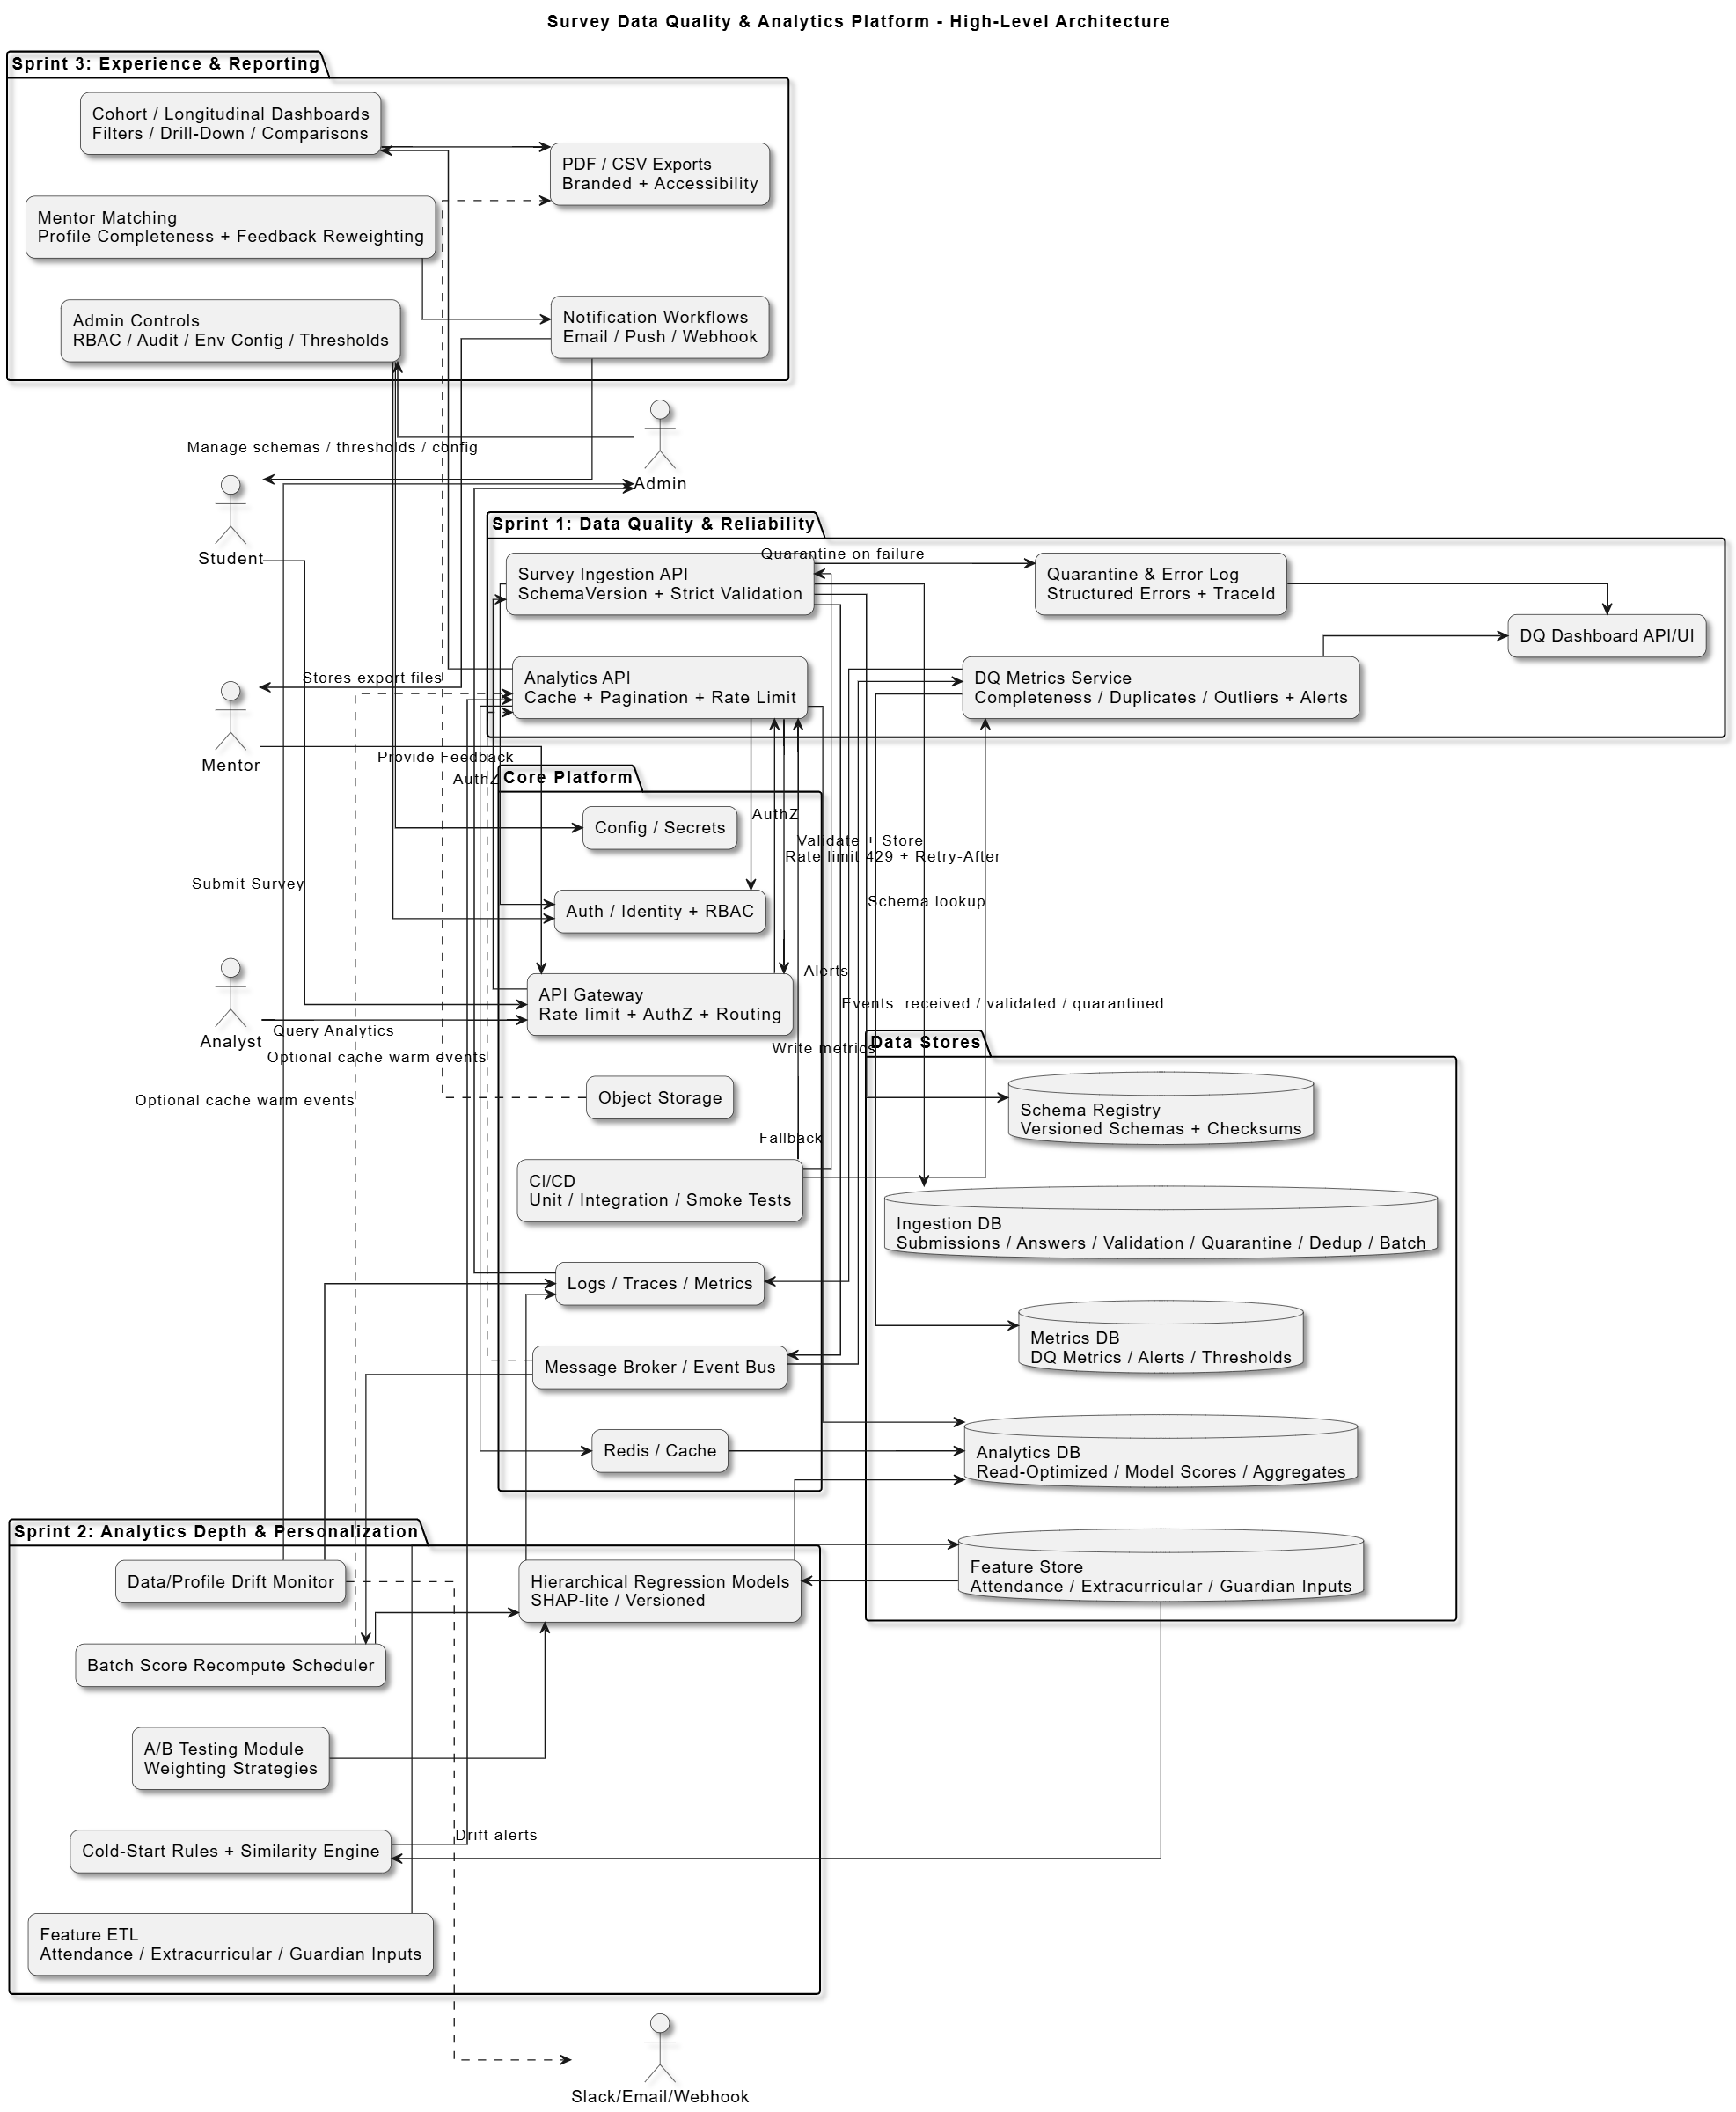
High Level Architecture

Slide 7
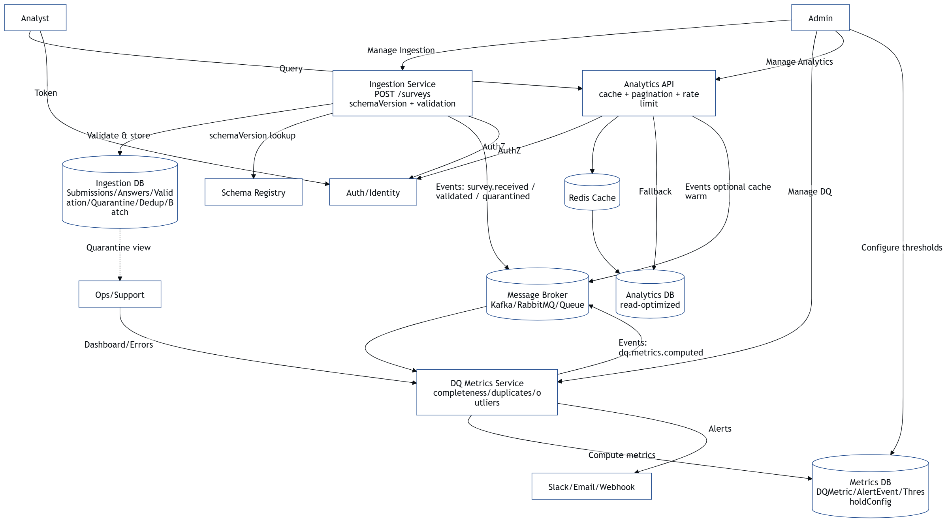
Low Level Architecture

Slide 8
Implementation Details
Backend (Flask / Python)
App setup: backend/app.py configures Flask with CORS, Swagger, Socket.IO, Celery, Redis, structured JSON logging. Uses config.py settings.
Auth & storage: SQLite for users/assessments/surveys (get_db_connection(), init_auth_db(), init_surveys_table()); passwords hashed via werkzeug.security.
Survey ingestion: Required columns in SURVEY_COLUMNS; normalization via _normalize_survey_value; SHA-256 hashes for deduplication; legacy Excel seeding via seed_surveys_from_dataframe.
Analytics modules:
Sentiment: Background, behavioral impact, family income, role models.
Career confidence: hierarchical_regression.py; handles empty data; outputs confidence modeling results.
Plots & XLSX artifacts: Stored under backend/assets/.
Vector store & mentor matching: PgVectorStore with pgvector DSN/dim from settings.
PDF generation: pdf_utils.py (generate_pdf_bytes) for downloadable reports.
Async & notifications: Celery + Redis; Twilio helper for SMS/email; SMTP email via EmailMessage.
API endpoints: Health checks, analysis (background/behavior/role model/income/complete), survey submission, assessments; Swagger docs enabled.

Slide 9
Implementation Details continued
Frontend (React / TypeScript)
Structure: frontend/src/ with pages/components; routing via App.tsx/main.tsx.
Key components:
Auth: LoginPage.tsx, SignupPage.tsx, VerifyEmailPage.tsx.
Survey: SurveyForm.tsx (backend integration via utils/api.ts).
Analytics dashboards: AnalyticsDashboard.tsx + subcomponents (BackgroundAnalysis, BehavioralImpact, IncomeDistribution, RoleModelAnalysis).
Recommendations & mentor matching: MentorConnections.tsx, DataDrivenPaths.tsx, StudentAssessment.tsx, MyAssessments.tsx.
Resources/help: Resources.tsx, About.tsx.
Styling & build: Tailwind, PostCSS, Vite bundler; Jest + React Testing Library for component tests.
Data & Assets
Survey Excel/CSV files, plots, XLSX exports, RL weights (role_model_rl_weights.pkl) under models/.
SQLite database surveys.db for auth/assessments; pgvector DSN for vector store; Redis cache for hot reads.

Slide 10
Challenges & Mitigation
Challenges
Data quality & duplicates: Legacy survey rows lacked unique IDs and had inconsistent fields. Mitigation: Normalized inputs, hashed rows (compute_survey_row_hash), backfilled legacy records, enforced unique indexes, and cleaned duplicates.
Sparse/empty datasets for modeling: Risk of crashes or unreliable regression outputs. Mitigation: Guardrails to short-circuit on empty data, normalized missing values before hierarchical regression and sentiment analysis.
Schema drift across legacy files: Excel/CSV sources vary; ingestion could fail silently. Mitigation: Explicit SURVEY_COLUMNS, normalization helpers, ALTER TABLE fallbacks wrapped in try/except for safe, idempotent migrations.
Performance & responsiveness: Analytics can be heavy; API may slow under load. Mitigation: Redis caching, Celery for async tasks, caching hooks around analysis endpoints.
Secure, reliable auth: Needed basic security without a full IAM stack. Mitigation: Hashed passwords, role checks, verification tokens, email/SMS hooks; schema migrations guarded to prevent downtime.
How We Addressed Them
Validation + dedup pipeline at ingest; deterministic SHA-256 hashes and unique index.
Defensive coding: empty-data checks, normalization for null/whitespace, safe schema migrations.
Modular analytics: separate sentiment modules and regression pipeline; rerunnable on new data.
Infra hooks: Redis/Celery for async/caching; JSON logging for observability.
Auth hygiene: hashed passwords, verification flow, and role constraints.

Slide 11
References
Kolog, E.A., Montero, C.S., Tukiainen, M., 2017. Development and evaluation of an automated e-counselling system for emotion and sentiment analysis. Int. J. Educ. Technol. High. Educ. 14, 41.
Kastrati, Z., Dalipi, F., Imran, A.S., Nuci, K.P., Wani, M.A., 2021. Sentiment analysis of students' feedback with NLP and deep learning: A systematic mapping study. Appl. Sci. 11(9), 3986.
Shaik, T., Tao, X., Dann, C., Xie, H., Li, Y., Galligan, L., 2023. Sentiment analysis and opinion mining on educational data: A survey. arXiv preprint arXiv:2302.04359.
Tamrakar, L., Shrivastava, P., Ghosh, S.M., 2021. Student sentiment analysis using classification with feature extraction techniques. arXiv preprint arXiv:2102.05439.
Zhao, X., Luan, X., Liu, X., Wang, H., 2021. Sentiment analysis of public opinions on the higher education expansion policy in China. SAGE Open 11(3), 1–15.
Awad, M., Khalil, E., 2022. Sentiment analysis in learning resources. J. Comput. Educ. 9, 143–160.
Khan, S., Ahmad, R., Khan, M., 2022. Feedback on e-learning using a hybrid fuzzy model. Appl. Sci. 13(23), 12956.
Rizvi, S.T., Gupta, R., Malhotra, A., 2022. Integrating sentiment analysis with learning analytics for improved student outcomes. Int. J. Educ. Technol. High. Educ. 19, 76.
Patel, N., Rao, R., 2020. Counselling for students using sentiment analysis. Int. J. Adv. Res. Comput. Sci. 11(4), 124–132.
Singh, D., Verma, A., 2023. Sentiment analysis of high school students' feedback for predicting career choices. IEEE Access, 11, 87654–87670.

